Slide 1

Exam Made Easy
GOOFBYE PAPERS! ☺
Project Adviser: Md. Hadifur Rahman Assistant Professor, Dept. of CSE, MBSTU
Project By: Rashid Abrar. ID: CE-15021

Slide 2
Introduction
Exam Made Easy is an online examination system. Here the student sits in front of a computer at the examination center and the questions are presented on the computer monitor and the student answer the question on the computer through the use of mouse. Unlike the traditional paper-pencil based test which is generally offered on a single day to all students. Instant result will be given to both student and teacher which will save time.

Slide 3
Objectives
• Create a Web application to be used in place of old paper based user examination process.
• Online examination can reduce the hectic job of assessing the answers given by candidates manually.
• Responses or the answers by the candidates can be checked automatically and instantly.
• It will reduce paper work to be an integrated Online Examination System. The result can be shown immediately to the students reducing the anxiety.

Slide 4
Scope
• Exam Made Easy is designed for Educational Institutes like Schools, Colleges, and Private Institutes to conduct logic tests.
• Can be used anywhere any time as it is web based application
• No restriction that examiner has to be present when the candidate take the test

Slide 5




Used Technology : Front End

Slide 6


Used Technology : Back End

Slide 7

Used Technology : Server

Slide 8

Used Technology : Database

Slide 9
Features
Two Types User
Paper Free Exam
MCQ Questions
Easy to create
Easy to use
Instant Evaluation
Instant Result
Saves Time
Student
Teacher
No need of examiner

Slide 10
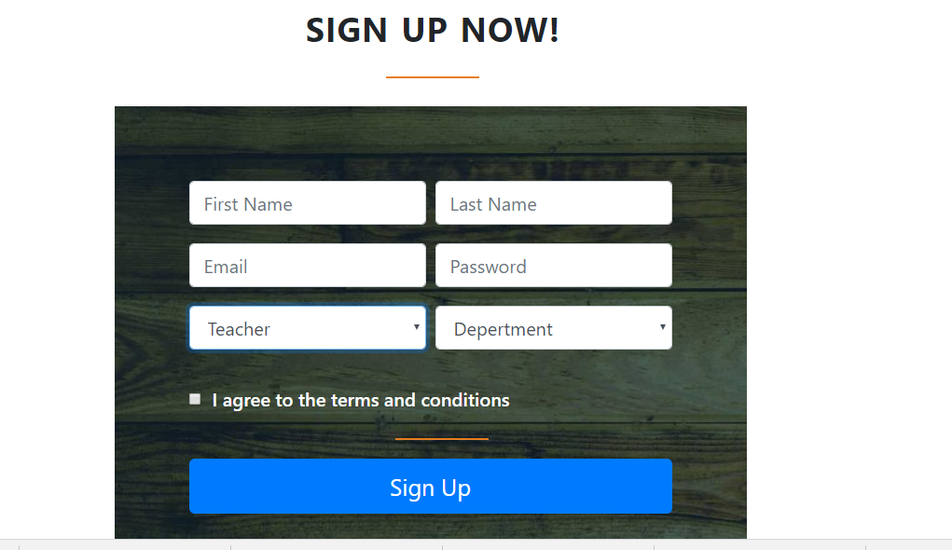
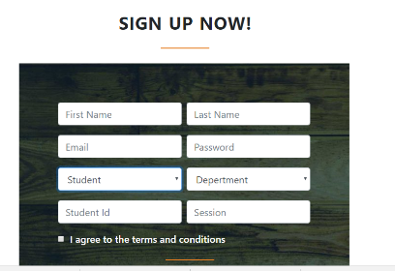
Sign Up
Teacher Sign Up
Student Sign Up

Slide 11
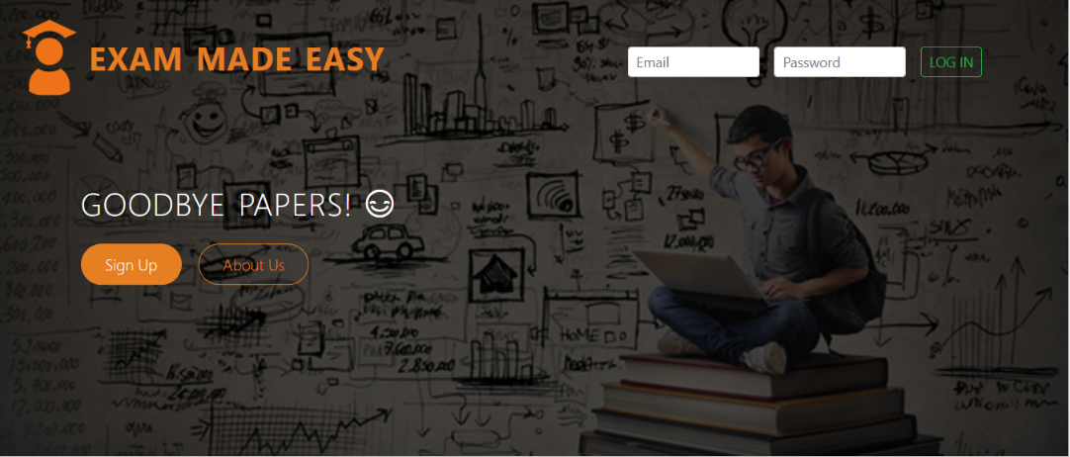
Login

Slide 12
Teacher Mode
In teacher mode, teacher can create exam, set question paper, access students lists and their results.

Slide 13
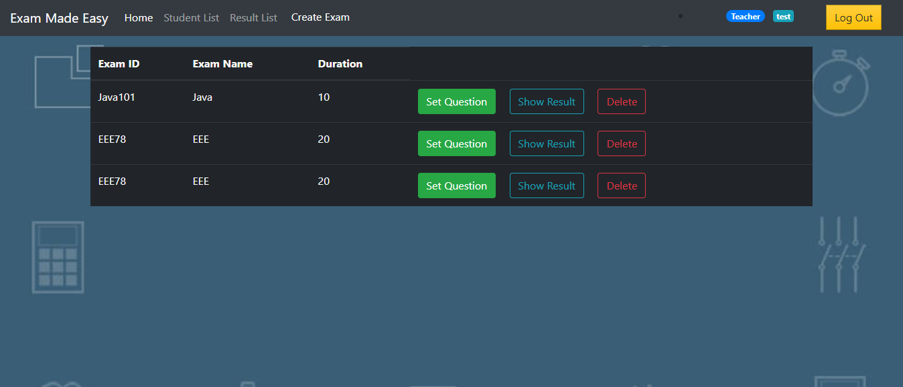
Teacher-Home

Slide 14
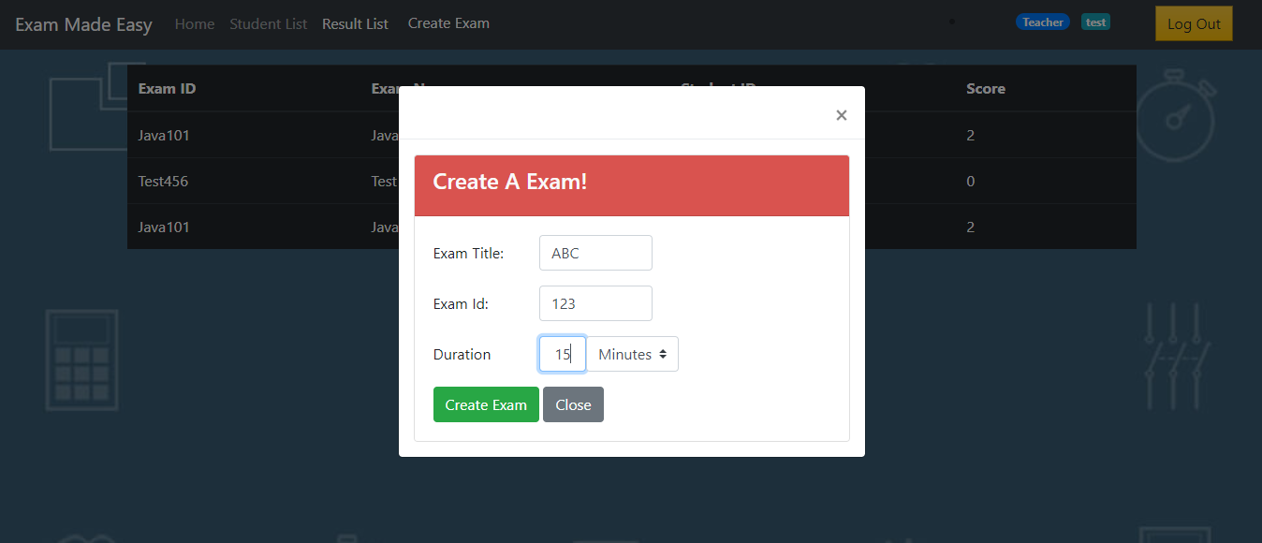
Create Exam

Slide 15
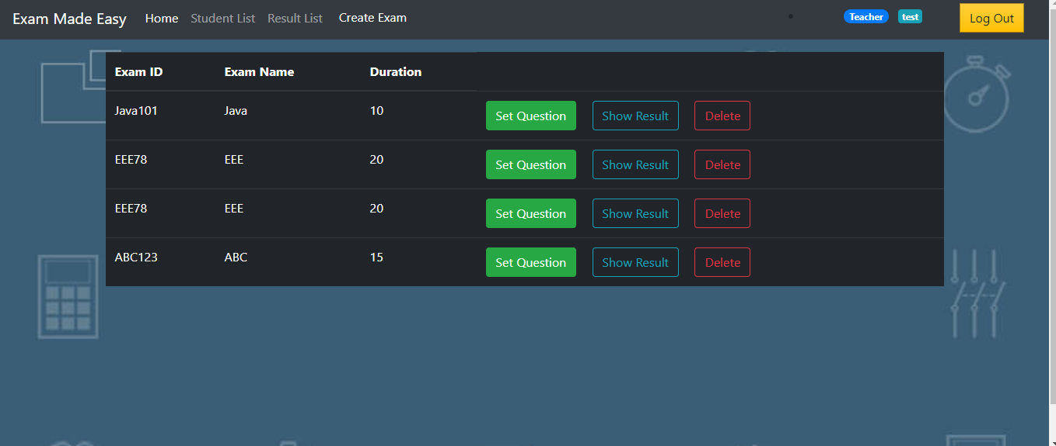
Create Exam

Slide 16
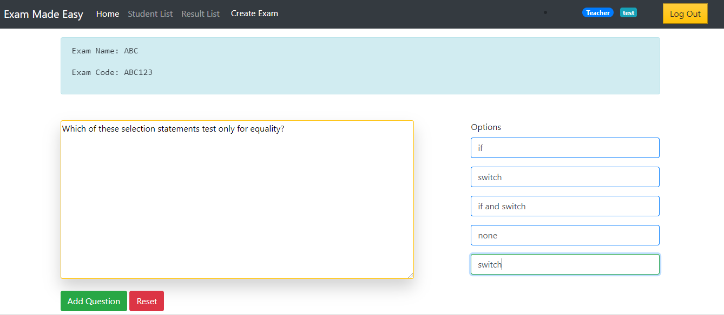
Set Question

Slide 17
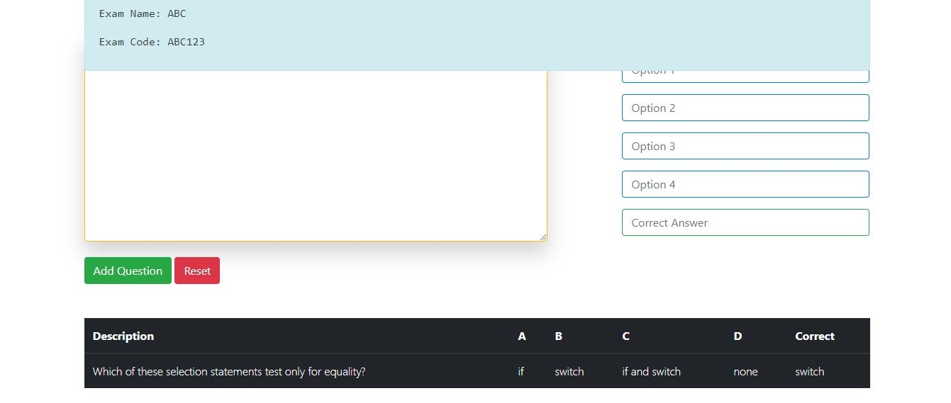
Set Question

Slide 18
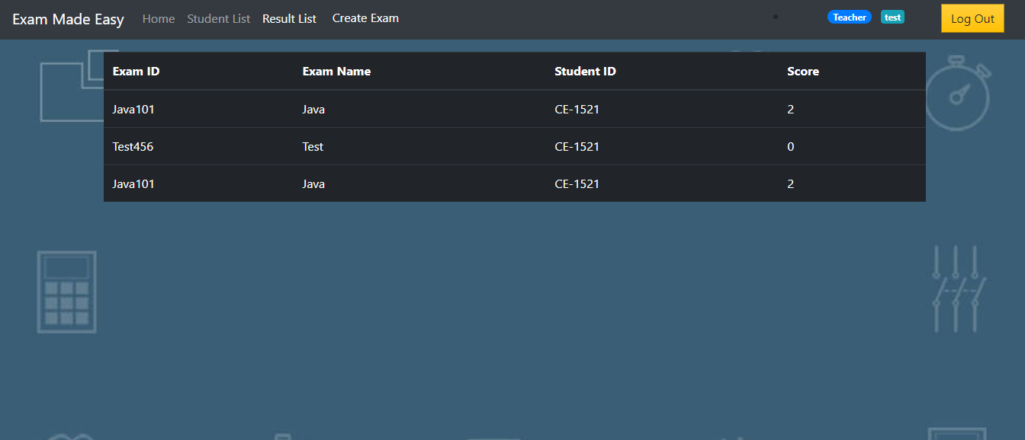
Result List

Slide 19
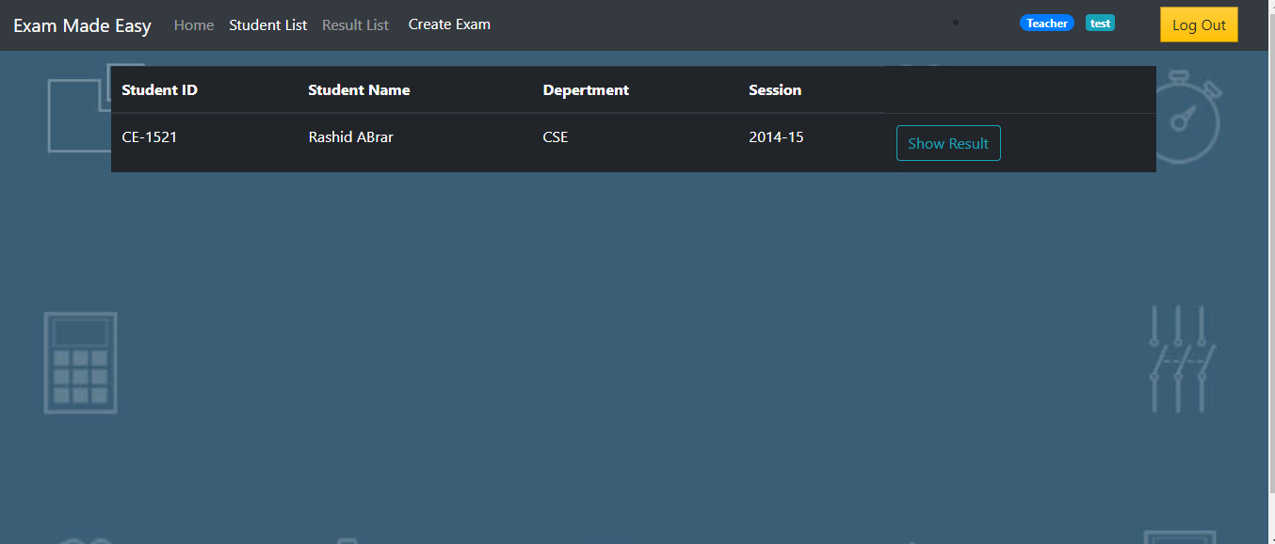
Student List

Slide 20
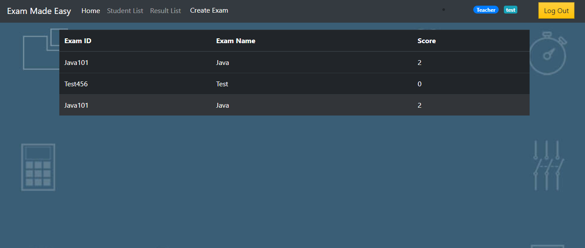
Student Result

Slide 21
Result

Slide 22
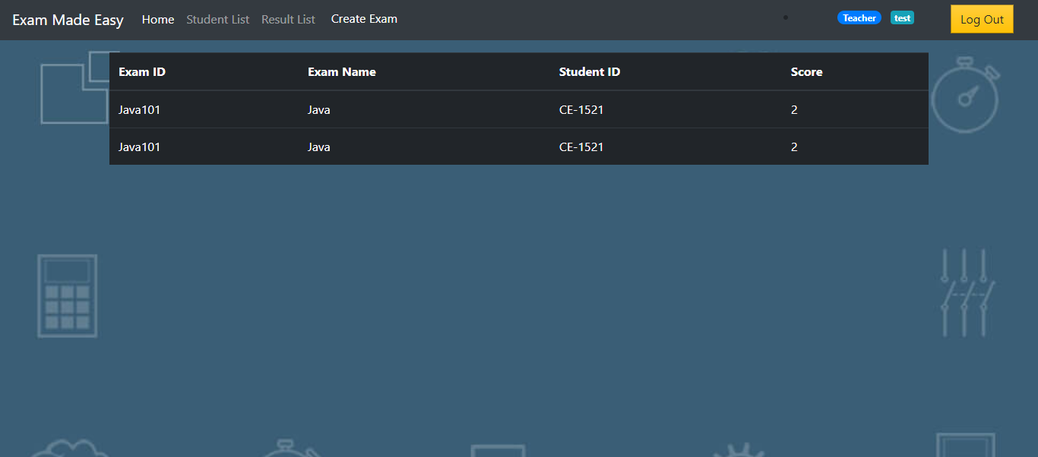
Result

Slide 23
Student Mode
In student mode, student can test themselves by various exams created by teachers. After exam, they can see their exam result. They can see their previous exam results also.

Slide 24
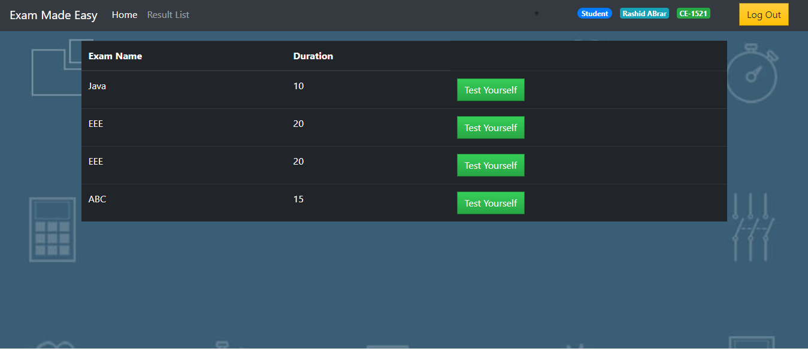
Student-Home

Slide 25
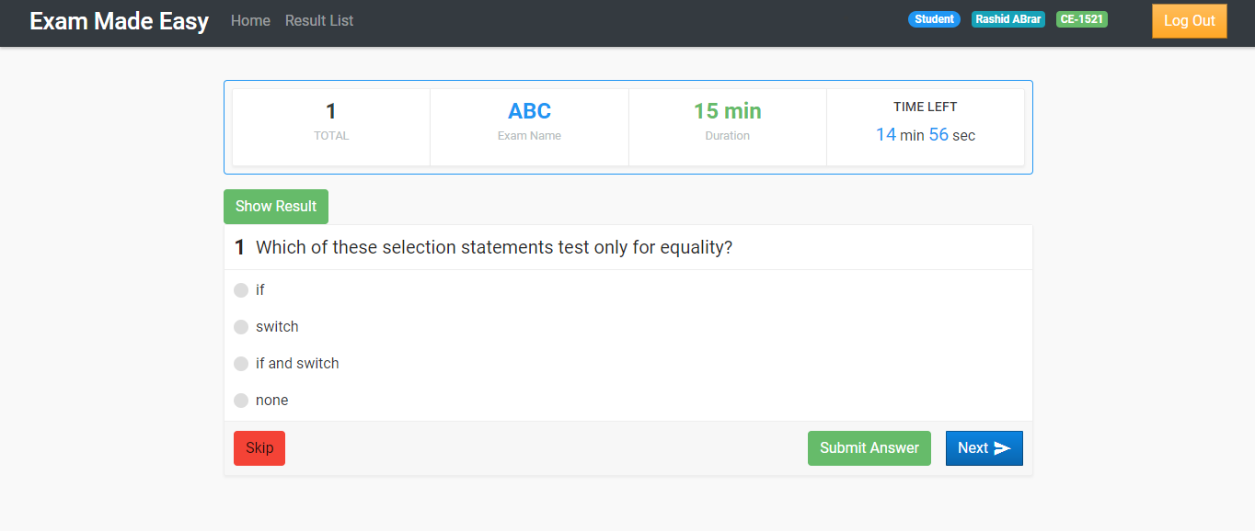
Test Yourself

Slide 26
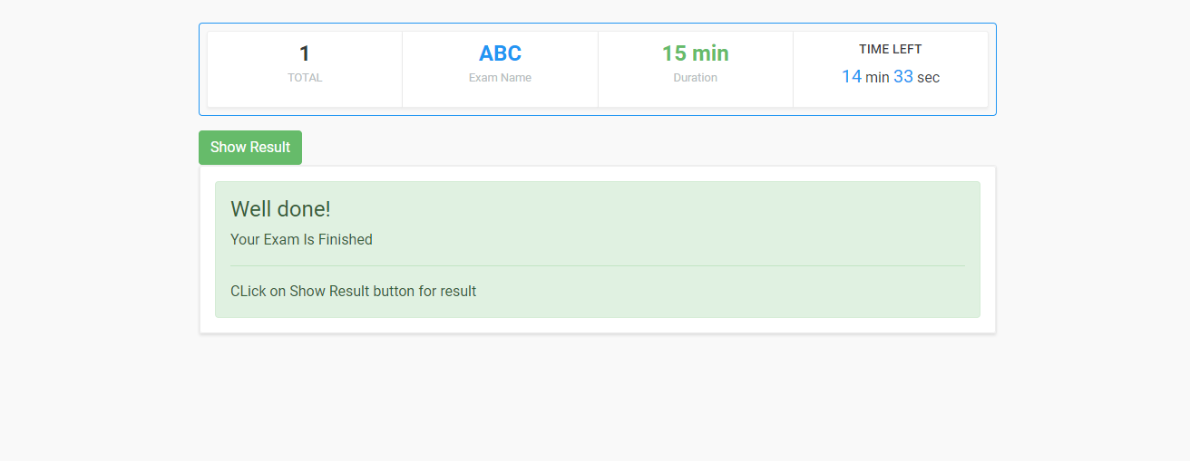
Exam Finished

Slide 27
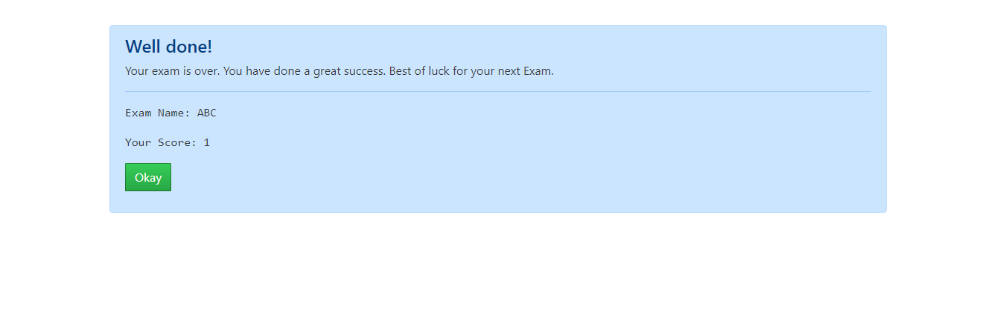
Result Sheet

Slide 28
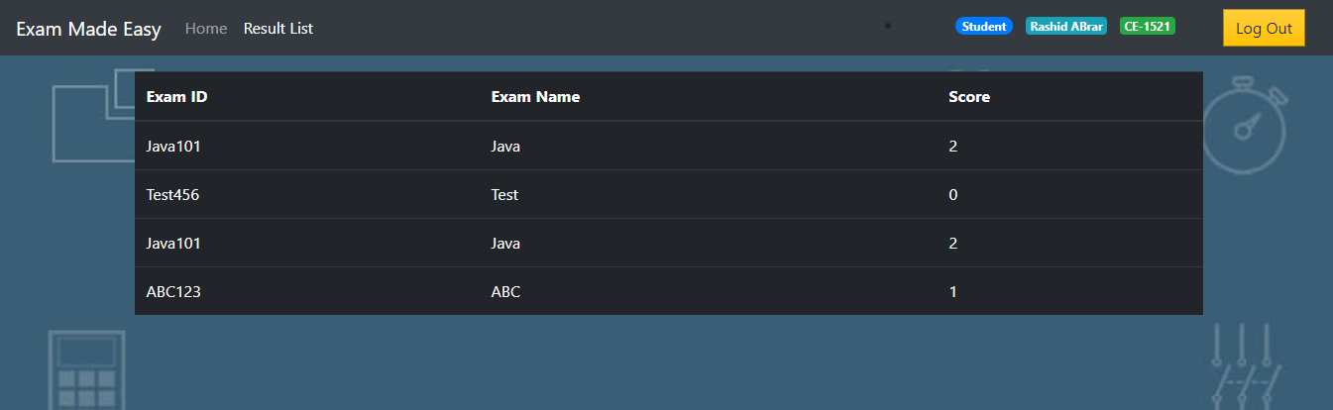
Result

Slide 29
Limitations
• Only MCQ exam is possible
• Questions with diagram or image is not possible

Slide 30
Future of this project
• Descriptive questions with figures
• Model tests
• Admission exams

Slide 31

Q&A

Slide 32


